Slide 1
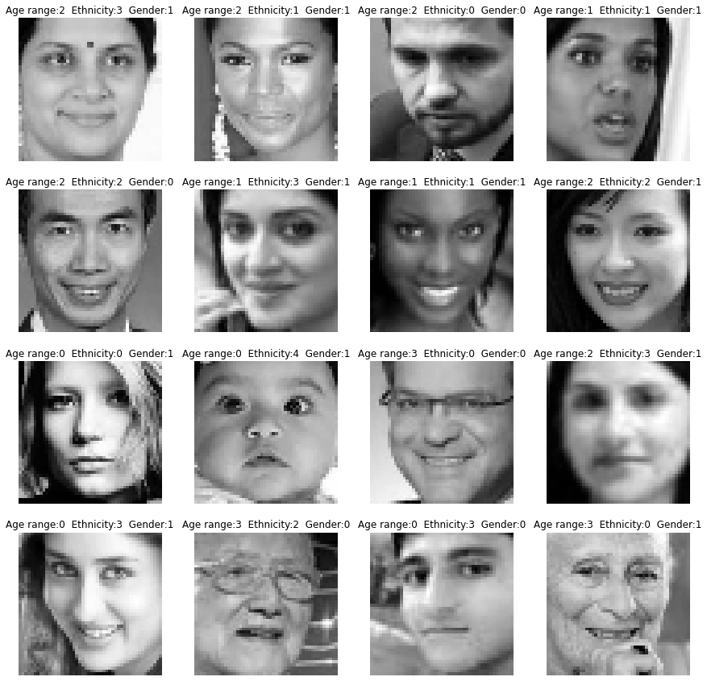
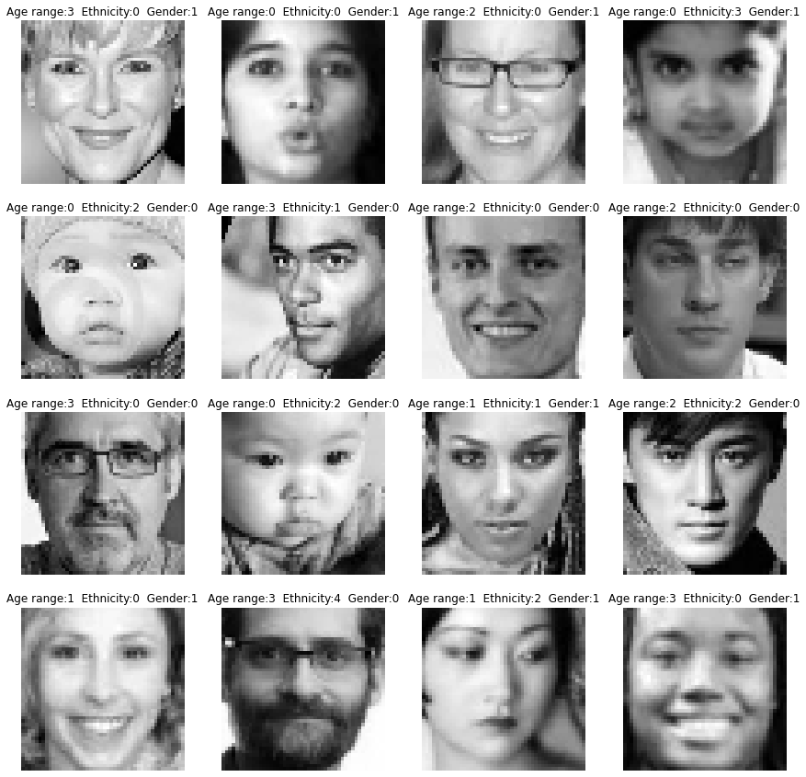
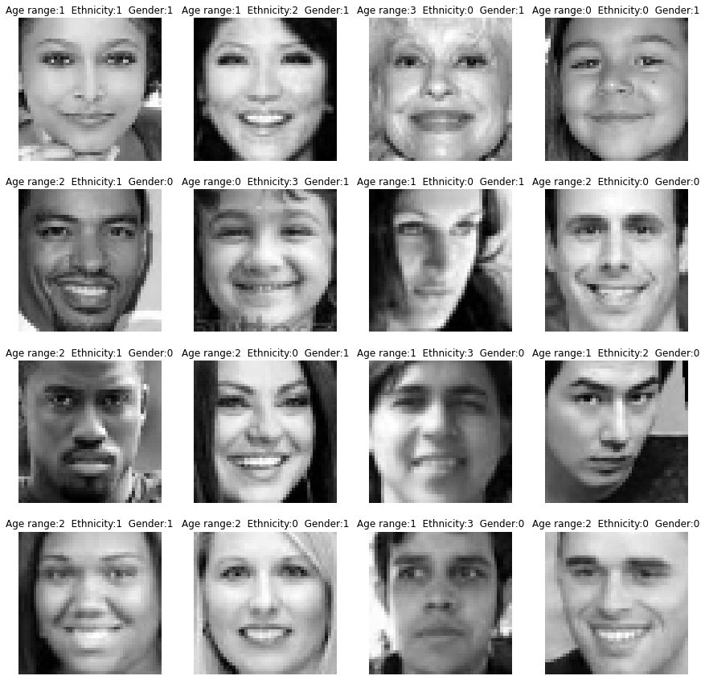
Face Image Classification

Slide 2
Face Image Classification with CNNs to Age, Ethnicity and Gender
Shu-wei Huang

Slide 3
Data
Data from: https://www.kaggle.com/datasets/nipunarora8/age-gender-and-ethnicity-face-data-csv
Face images, Age, Ethnicity and Gender are in CSV file

Slide 4
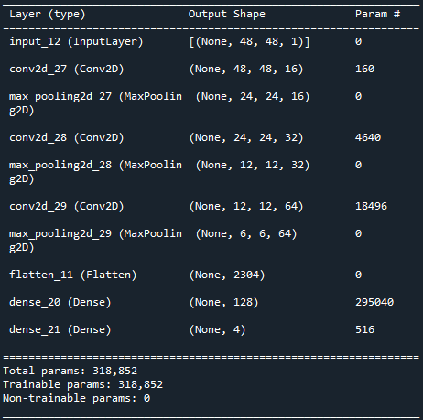
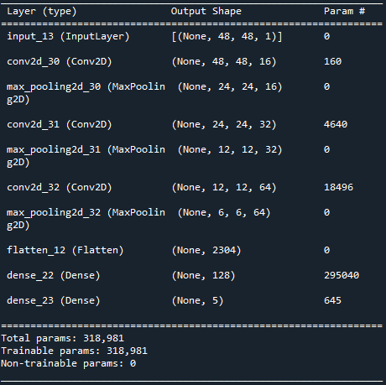

Models
Build 3 CNN models to classify to Age, Ethnicity and Gender.
Age model
Ethnicity model
Gender model

Slide 5

Pandas
Pandas in this practice is used to read csv file and process data for training the models.
Read .csv
Remove useless information “image name”
Separate data into train and test data
Train and test data include three sets for build the association between images and Age, Ethnicity and Gender.

Slide 6
Result
Accuracy (Age): 61 %
Accuracy (Ethnicity): 75 %
Accuracy (Gender): 88 %

Slide 7
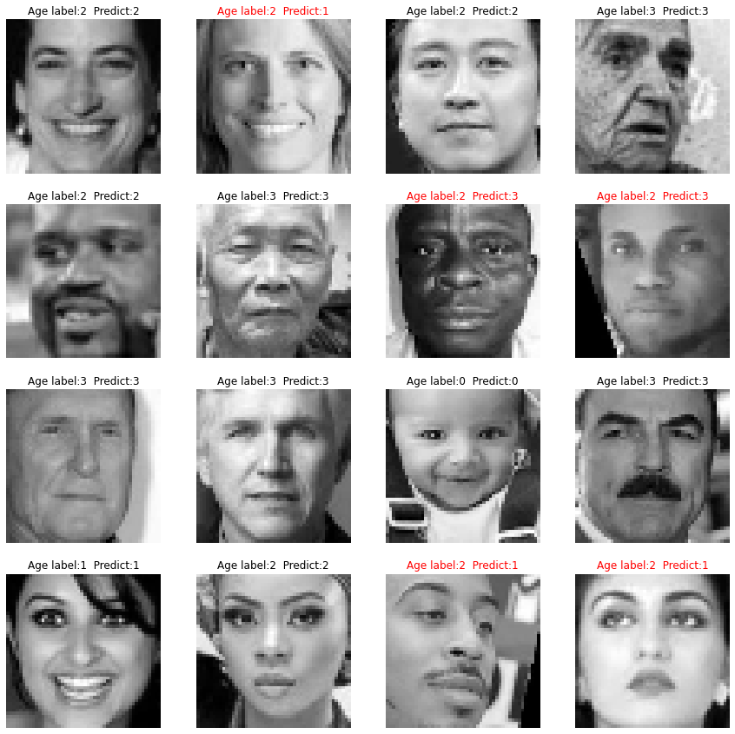
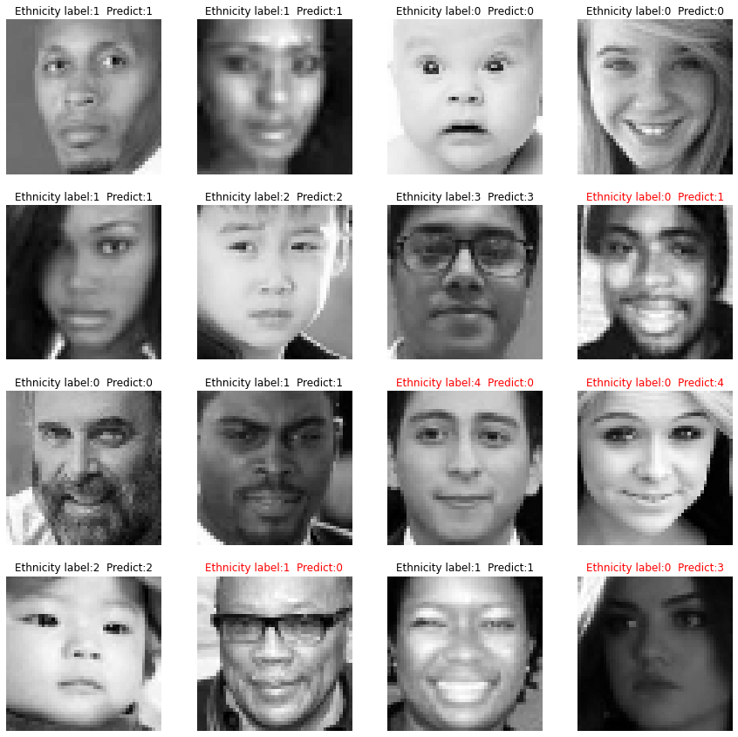
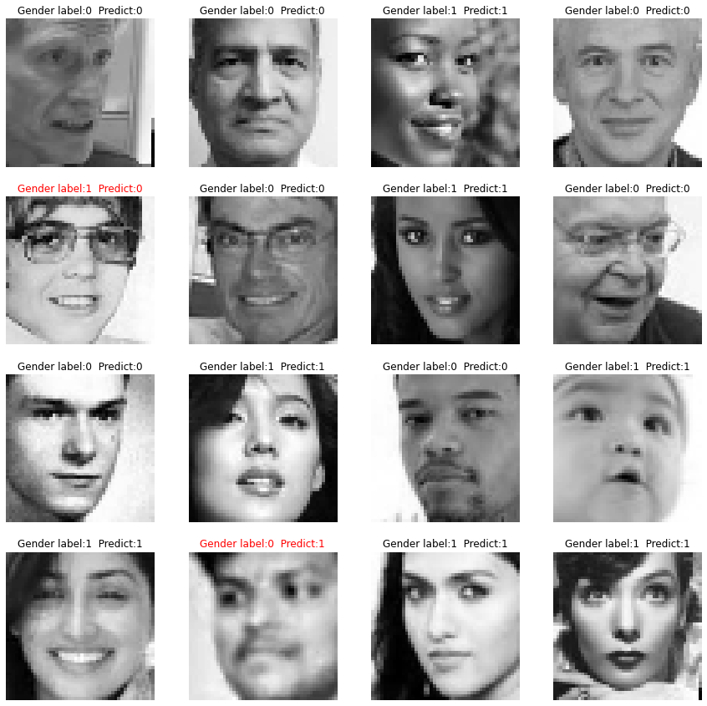
Result
Age prediction
Ethnicity prediction
Gender prediction

